Slide 1
Using Association Rules for Fraud Detection in Web Advertising Networks
Ahmed Metwally
Divyakant Agrawal
Amr El Abbadi
Department of Computer Science
University of California, Santa Barbara

Slide 2
Outline
Introduction
  Motivating Applications
Problem Formalization
  Problem Definition: Association Rules in Data Streams
Which Elements to Count Together?
  The Unique-Count Technique
A Feasible Counting Algorithm
  The Streaming-Rules Algorithm
Experimental Results
Conclusion

Slide 3

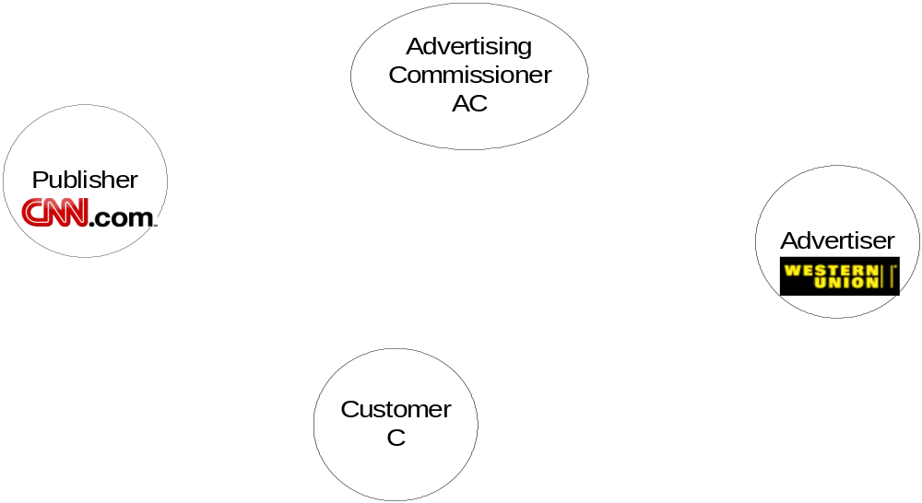


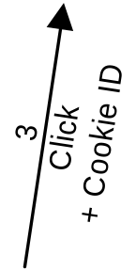
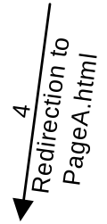

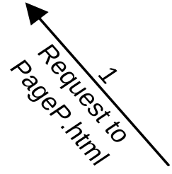

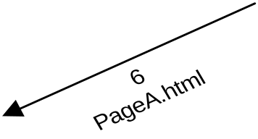

The Advertising Network Model
Motivated by Internet Advertising Commissioners
$$: Detect hit-inflation fraud done by publishers

Slide 4
It seems like a Famous Problem
“When Advertisers Pay by the Look, Fraud Artists See Their Chance”
    David Vise
    Washington Post
    April 17, 2005; Page F01
Previous Work [Metwally et al. WWW’05]
  Detecting Duplicate in Click Streams
    Fraud (27% of traffic) was detected in Live data

Slide 5
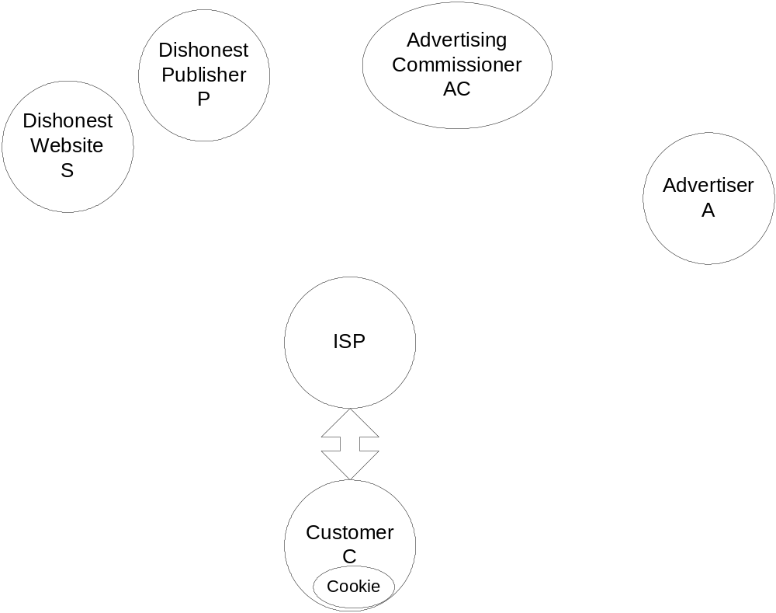
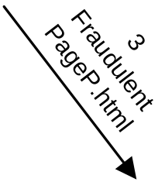
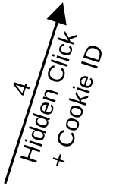
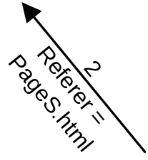
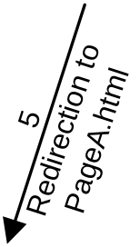
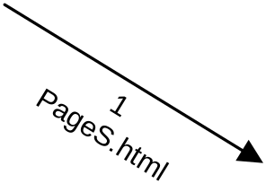
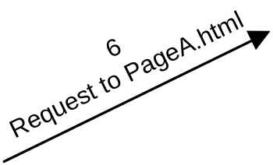
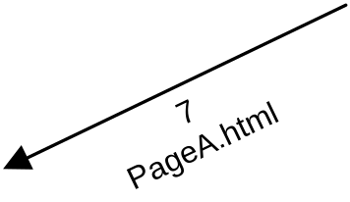
[Anupam et al. WWW‘99] Hit-Inflation Attack

Slide 6
[Anupam et al. WWW‘99] Hit-Inflation Characteristics
[Anupam et al. WWW‘99] hit inflation fraud technique
  Coalition: Dishonest Publisher P and Dishonest Site S
  Two versions of PageP.html: non-Fraudulent and Fraudulent
  If Customer C is referred from S: P loads Fraudulent PageP.html. Otherwise, P loads non-Fraudulent PageP.html

Slide 7
Why is it Difficult to Detect?
Duplicate Detection Does not work
Commissioner does not know Referer field value for HTTP calls to Publishers
Hidden from the Customer
A normal Visit: non-Fraudulent PageP.html

Slide 8
Detecting Anupam’s Attack
We call for coalition between Advertising Commissioners and ISPs.
ISP: Which Websites precede what Websites?
We are interested in popular pairs of elements

Slide 9
Mining Association Rules in Streams of Elements
Another Motivation:
  Predictive caching
    File Servers
    Search Engines
Model:
  Needs a new way to model streams generated by activity of more than one customer
  Previous work [Chang et al. SIGKDD’03, Teng et al. VLDB’03, Yu et al. VLDB’4] assumed streams of transactions or sessions

Slide 10
Formalizing the Problem
Assumptions 1: Stream of Elements
  Previous work [Chang et al. SIGKDD’03, Teng et al. VLDB’03, Yu et al. VLDB’04] assumed streams of transactions or sessions
  This is not always applicable
  ISPs tracking HTTP requests of customers individually:
    Privacy violation (US CODE: Title 18, Part I, Chapter 119, section 2511)
    Technically, NAT boxes hide thousands of computers
  Search Engines: Not all of them use cookies
  File Servers: distributed applications blur sessions

Slide 11
Formalizing the Problem (cont.)
Assumptions 2: Causality Span
  Causality holds between temporally close element pairs
Assumptions 3: Lost History
  The server cannot store the entire history. It only stores a current window of elements.
Assumptions 4: Independent Duplicates
  Duplicate pairs assumed issued by different Customers
Assumptions 5: No False Negatives
  Give counting the benefit of doubt
  Stream = aab ➔ Count(a,b) = 1
  Stream = aabb ➔ Count(a,b) = 2
  Stream = abab ➔ Count(a,b) = 2

Slide 12
Problem Definition
Formal Definition
  Given a stream q₁, q₂, …, q_{I}, …, q_{N} of size N
  Assume causality holds within a span δ
  An association rule is an implication on the form x ➔ y
  The conditional frequency F(x, y) of x and y is the number of times distinct y’s follow distinct x’s within δ
  The frequency F(x) of x the number of occurrences of x
Antecedent
≠ Consequent

Slide 13
Problem Definition (cont.)
Two Variations
  Forward Association Rules:
    Motivated by search engines and file servers
    Focus on Antecedent: F(x) > φN
    Frequent conditional frequency: F(x, y) > ψ F(x)
  Backward Association Rules:
    Motivated by detecting Anupam’s fraud technique
    Focus on Consequent: F(y) > φN
    Frequent conditional frequency: F(x, y) > ψ F(y)
Both φ and ψ are user specified, 0 ≤ φ, ψ ≤ 1

Slide 14
Example
S = x x u u c g d c x f x u N = 12
F(x) = 4, F(u) = 3, F(f) = 1
Span between g and f is 4
Within span 2, F(c, d) = 1
Within span 3, F(u, g) = 1, only one possible pairing
For any span > 1, F(x, u) = 3, only 3 u’s
User Query: δ = 3, φ = 0.2, and ψ = 0.3
  Min support requirement = φN = 0.2 * 12 = 3
  Only x and u can be antecedents for forward association or consequents for backward association
Forward Association:
  For x, Min confidence requirement = ψ F(x) = 0.3 * 4 = 2
  For u, Min confidence requirement = ψ F(u) = 0.3 * 3 = 1
  Since δ = 3, rules are x ➔ u, u ➔ c, u ➔ g, u ➔ d

Slide 15
Guidelines on Pairing Elements
Element a cannot cause itself
For any two elements a and b, we cannot count one a for more than one b
Associate causality with the eldest possible element. This avoids underestimating counts.
The server cannot store the entire history. It only stores a current window of elements.
  The current window is at least δ + 1
It is not a simple problem to comply with such rules. WHY?

Slide 16
Example
δ = 5 S = a a
b
c
d
a
b
b
Assume current window = 6
b will be counted with a at q₁, Hence a at q₂ can be counted with another b later
Since the server cannot see the expired a, it will assume that b at q₃ is counted with a at q₂. Hence, b at q₇ is counted with a at q₆
The server cannot associate the new b at q₈ with any a, since the b at q₇ is counted with a at q₆
A more cautious counting results in F(a,b) = 3 instead of 2
Shall the server keep more history?

Slide 17
Example (Cont)
Assume we consider the forward association of a ➔ b
δ = 5 S = a
a b c d
a b c d
a b c d
…
b
The server needs the entire history for a correct F(a, b)
δ = 5 S = a
a b c d
a b c d
b
…
If current window = 6, the server counts only 2/3 * F(a, b)
Shall the server keep te entire history?

Slide 18
The Unique-Count Algorithm
Data Structures:
  For last element, q_{I}, keep Antecedent Set, t_{I}
    It contains elements that arrived before q_{I} and was counted with q_{I}.
    The set expires when observe a new element.
  For each element, q_{J}, in current window, keep Consequent Set, s_{J},
    It contains elements that arrived after q_{J} and was counted with q_{J} .
Space Complexity: O(δ²)
Processing time per element: O(δ)

Slide 19
Unique-Count By Example
δ = 3 S = a
a
b
b
a
F(a,b) = 1
Unique-Count Technique
  For each arriving element, q_{I}, scan the previous δ elements in order of arrival, from old to new.
    For every scanned element, q_{J}
      If (q_{J} ≠ q_{I}) and (q_{J} ∉ t_{I} ) and (q_{I} ∉ s_{J})
        Count q_{I} for q_{J}
        Insert q_{J} into t_{I} and q_{I} into s_{J},
Unique-Count Technique
  For each arriving element, q_{I}, scan the previous δ elements in order of arrival, from old to new.
    For every scanned element, q_{J}
      If (q_{J} ≠ q_{I}) and (q_{J} ∉ t_{I} ) and (q_{I} ∉ s_{J})
        Count q_{I} for q_{J}
        Insert q_{J} into t_{I} and q_{I} into s_{J},

Slide 20
Unique-Count By Example
δ = 3 S = a
a
b
c
b
a
a
F(a,b) = 1
c
F(a,c) = 1
Unique-Count Technique
  For each arriving element, q_{I}, scan the previous δ elements in order of arrival, from old to new.
    For every scanned element, q_{J}
      If (q_{J} ≠ q_{I}) and (q_{J} ∉ t_{I} ) and (q_{I} ∉ s_{J})
        Count q_{I} for q_{J}
        Insert q_{J} into t_{I} and q_{I} into s_{J},
Unique-Count Technique
  For each arriving element, q_{I}, scan the previous δ elements in order of arrival, from old to new.
    For every scanned element, q_{J}
      If (q_{J} ≠ q_{I}) and (q_{J} ∉ t_{I} ) and (q_{I} ∉ s_{J})
        Count q_{I} for q_{J}
        Insert q_{J} into t_{I} and q_{I} into s_{J},

Slide 21
Unique-Count By Example
δ = 3 S = a
a
b
c
b
c
a
F(a,b) = 1
c
b
F(a,c) = 1
F(b,c) = 1
Unique-Count Technique
  For each arriving element, q_{I}, scan the previous δ elements in order of arrival, from old to new.
    For every scanned element, q_{J}
      If (q_{J} ≠ q_{I}) and (q_{J} ∉ t_{I} ) and (q_{I} ∉ s_{J})
        Count q_{I} for q_{J}
        Insert q_{J} into t_{I} and q_{I} into s_{J},
Unique-Count Technique
  For each arriving element, q_{I}, scan the previous δ elements in order of arrival, from old to new.
    For every scanned element, q_{J}
      If (q_{J} ≠ q_{I}) and (q_{J} ∉ t_{I} ) and (q_{I} ∉ s_{J})
        Count q_{I} for q_{J}
        Insert q_{J} into t_{I} and q_{I} into s_{J},

Slide 22
Unique-Count By Example
δ = 3 S = a
a
b
c
b
b
b
c
a
F(a,b) = 1
F(a,b) = 2
c
F(a,c) = 1
F(b,c) = 1
Unique-Count Technique
  For each arriving element, q_{I}, scan the previous δ elements in order of arrival, from old to new.
    For every scanned element, q_{J}
      If (q_{J} ≠ q_{I}) and (q_{J} ∉ t_{I} ) and (q_{I} ∉ s_{J})
        Count q_{I} for q_{J}
        Insert q_{J} into t_{I} and q_{I} into s_{J},
Unique-Count Technique
  For each arriving element, q_{I}, scan the previous δ elements in order of arrival, from old to new.
    For every scanned element, q_{J}
      If (q_{J} ≠ q_{I}) and (q_{J} ∉ t_{I} ) and (q_{I} ∉ s_{J})
        Count q_{I} for q_{J}
        Insert q_{J} into t_{I} and q_{I} into s_{J},

Slide 23
Unique-Count By Example
δ = 3 S = a
a
b
c
b
b
b
c
b
a
F(a,b) = 2
c
c
F(a,c) = 1
F(b,c) = 1
F(c,b) = 1
Unique-Count Technique
  For each arriving element, q_{I}, scan the previous δ elements in order of arrival, from old to new.
    For every scanned element, q_{J}
      If (q_{J} ≠ q_{I}) and (q_{J} ∉ t_{I} ) and (q_{I} ∉ s_{J})
        Count q_{I} for q_{J}
        Insert q_{J} into t_{I} and q_{I} into s_{J},
Unique-Count Technique
  For each arriving element, q_{I}, scan the previous δ elements in order of arrival, from old to new.
    For every scanned element, q_{J}
      If (q_{J} ≠ q_{I}) and (q_{J} ∉ t_{I} ) and (q_{I} ∉ s_{J})
        Count q_{I} for q_{J}
        Insert q_{J} into t_{I} and q_{I} into s_{J},

Slide 24
Is the Problem Solved?
Yes, we know which elements to count together for association.
No, this is not practical.
We cannot keep counters for all possible pairs of elements
We need an efficient algorithm to count frequent associated with other frequent element
We need to count nested frequent elements in data streams

Slide 25
Nesting Frequent Elements Algorithms
If we have a counter-based algorithm, Λ, that finds φ-frequent elements in streams, we use it to find antecedents of rules.
For every antecedent, x, we use Λ to find consequents, elements occurred after x within δ, which satisfy ψ F(x).
Λ can be our algorithm Streaming-Rules [Metwally et al. ICDT’05], or one of [Manku et al. VLDB’02] algorithms.

Slide 26


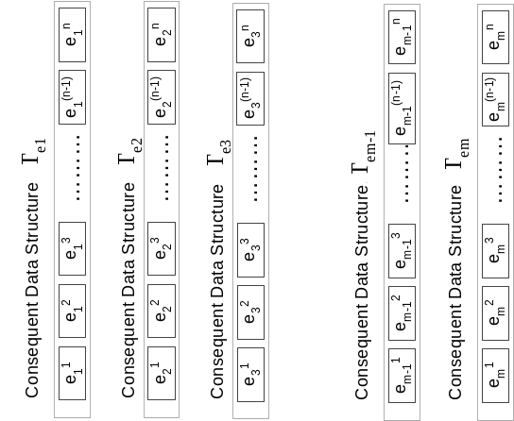
Nesting Frequent Elements Data Structure
The Λ algorithm keeps a Γ data structure to estimate counts of frequent antecedents.
For every frequent antecedents, x, a nested data structure Γ_{x} is kept to estimate the counts of frequent consequents.

Slide 27
The Space-Saving Algorithm
Space-Saving [Metwally et al. WWW’05] is a counter-based algorithm
Monitor only m elements in a Stream-Summary data structure
Frequency estimation is more accurate for significant elements
Keep track of max. possible overestimation errors for each element
Properties:
  No. of counters < 1/ε, ε is user specified error
  An element, x, with F(x) > ε N, is guaranteed to be monitored

Slide 28
Space-Saving By Example
Element
Count
error (max possible)
Element | A | B | C
Count | 2 | 2 | 1
error (max possible) | 0 | 0 | 0
Element | A | B | C
Count | 3 | 2 | 1
error (max possible) | 0 | 0 | 0
Element | B | A | C
Count | 4 | 3 | 1
error (max possible) | 0 | 0 | 0
Element | B | A | D
Count | 4 | 3 | 2
error (max possible) | 0 | 0 | 1
Element | B | A | D
Count | 5 | 3 | 3
error (max possible) | 0 | 0 | 1
Element | B | E | A
Count | 5 | 4 | 3
error (max possible) | 0 | 3 | 0
Element | B | E | C
Count | 5 | 4 | 4
error (max possible) | 0 | 3 | 3
A
B
B
A
C
A
B
B
D
D
B
E
C
Space-Saving Algorithm
  For every element in the stream S
    If a monitored element is observed
      Increment its Count
    If a non-monitored element is observed,
      Replace the element with minimum hits, min
      Increment the minimum Count to min + 1
      maximum possible over-estimation is error
Space-Saving Algorithm
  For every element in the stream S
    If a monitored element is observed
      Increment its Count
    If a non-monitored element is observed,
      Replace the element with minimum hits, min
      Increment the minimum Count to min + 1
      maximum possible over-estimation is error
Space-Saving Algorithm
  For every element in the stream S
    If a monitored element is observed
      Increment its Count
    If a non-monitored element is observed,
      Replace the element with minimum hits, min
      Increment the minimum Count to min + 1
      maximum possible over-estimation is error
Space-Saving Algorithm
  For every element in the stream S
    If a monitored element is observed
      Increment its Count
    If a non-monitored element is observed,
      Replace the element with minimum hits, min
      Increment the minimum Count to min + 1
      maximum possible over-estimation is error
Space-Saving Algorithm
  For every element in the stream S
    If a monitored element is observed
      Increment its Count
    If a non-monitored element is observed,
      Replace the element with minimum hits, min
      Increment the minimum Count to min + 1
      maximum possible over-estimation is error

Slide 29
The Streaming-Rules Algorithm
Streaming-Rules Algorithm
  For every arriving element, q_{I}, in the stream S
    Update Antecedent Stream-Summary using Space-Saving
    If q_{I} was not monitored before
      Initialize its Consequent Stream-Summary
    Identify elements that q_{I} should be counted for as a consequent using Unique-Count
    For each Identified element q_{J}
      Insert q_{I} into the Consequent Stream-Summary of q_{J} using Space-Saving

Slide 30
Querying the Nested Structure
Find-Forward Algorithm
  Scan Antecedent Stream-Summary until the scanned element does not satisfy minsup
  For each scanned element , q_{I}
    Scan Consequent Stream-Summary of q_{I} until the scanned element, q_{J}, does not satisfy minconf
    For each scanned element q_{J}
      Output q_{I} ➔ q_{J}

Slide 31
The Streaming-Rules Properties
Streaming-Rules is an algorithm that:
  Detects both forward and backward association between keywords or sites
  Space efficient
Streaming-Rules inherits some properties from Unique-Count:
  The processing time per element is O(δ)

Slide 32
The Streaming-Rules Properties (Cont)
Streaming-Rules inherits some properties from Space-Saving
  Using O(1/ε * 1/η) space, Streaming-Rules has overestimation rates bounded by ε in support , and η in confidence. Both ε and η are user specified errors
  A rule with guaranteed frequency, count - overestimation, that exceeds the thresholds is guaranteed to be correct
  An association rule x ➔ y, is guaranteed to be monitored in the consequent Stream-Summary of x if F(x) > ε N, and F(x, y) > η N

Slide 33
Experimental Setup
Data: both synthetic and obfuscated ISP log
Compare with Omni-Data, that uses the same Unique-Count technique, and Stream-Summary data structure, but keeps exact counters
Compare: run time and space usage
For Streaming-Rules, measure:
  Recall: number of correct elements found / number of actual correct
  Precision: number of correct elements found / entire output
  Guarantee: number of guaranteed correct elements found / entire output

Slide 34
Synthetic Data Experiments
Adaptation to data skew:
  Zipfian Data: skew parameter = 1, 1.5, 2, 2.5, 3
For all synthetic data, Streaming-Rules
  Recall = Precision = Guarantee = 1
Forward rules. φ = ψ = 0.1, δ = 10, 20
Streaming-Rules used a nested Stream-Summary with m = n =500 ➔ ε = 1/500, and η = 1/250

Slide 35
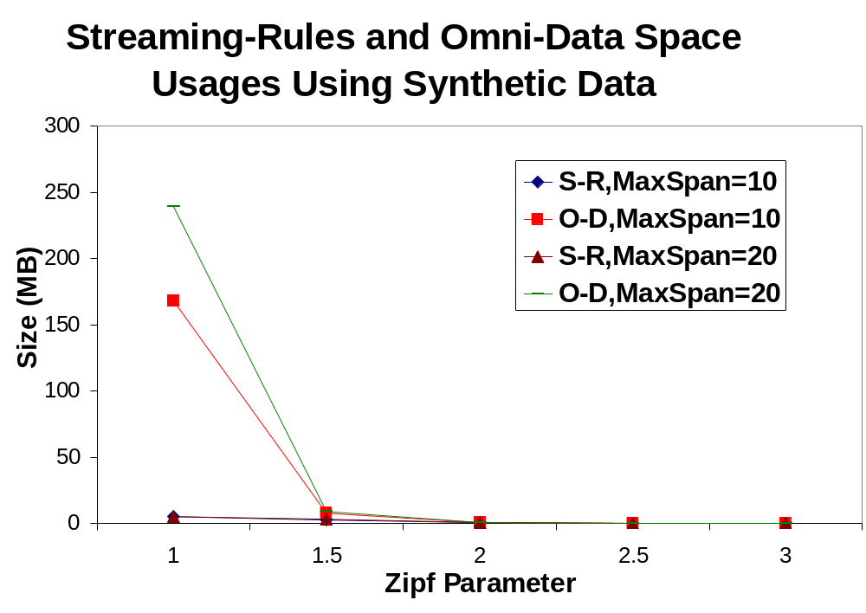
The Streaming-Rules Space Efficiency N = 3*10⁶

Slide 36
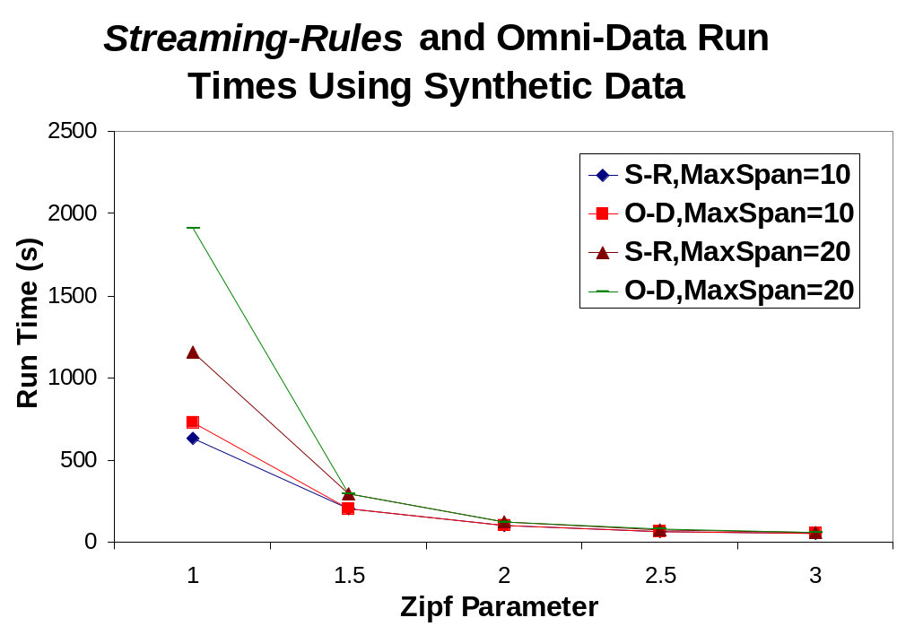
The Streaming-Rules Time Efficiency N = 3*10⁶

Slide 37
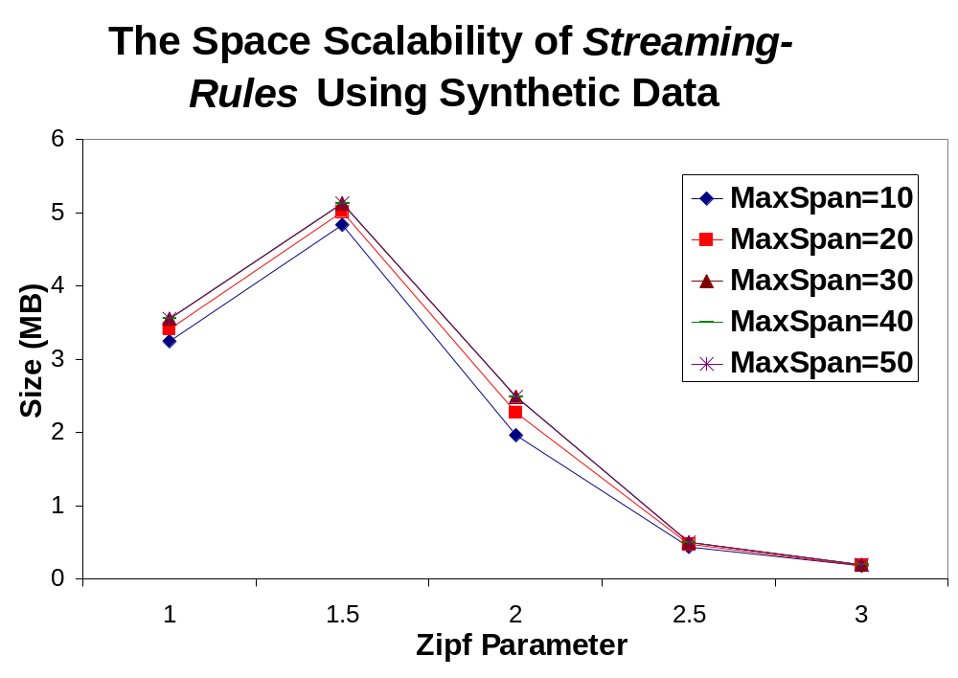
The Streaming-Rules Space Scalability N = 10⁷

Slide 38
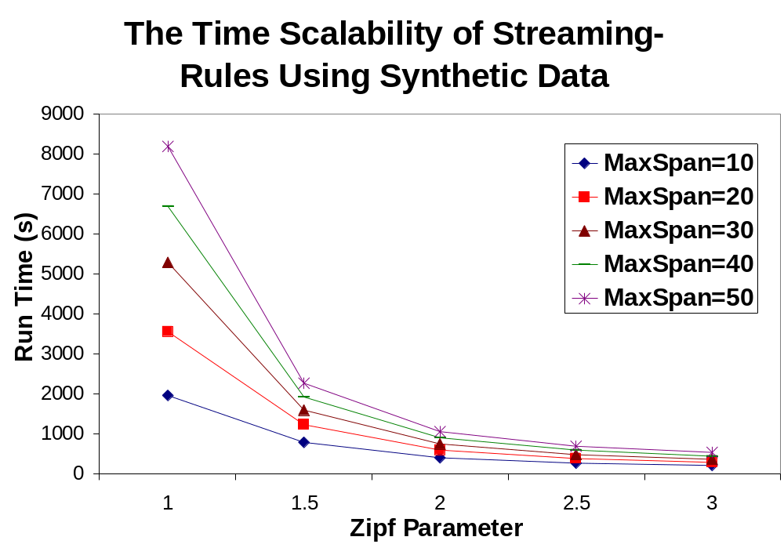
The Streaming-Rules Time Scalability N = 10⁷

Slide 39
Real Data Experiments
Obfuscated ISP data from Anonymous.com N = 678,191
For all synthetic data, Streaming-Rules
  Recall = 1, Precision and Guarantee varied from 0.97 to 0.99
Interesting results:
  Set of Suspicious antecedents, and a set of suspicious consequents
  The antecedents are not frequent
Backward rules. φ = 0.02, ψ = 0.5, δ = 10, 20, …, 100
Streaming-Rules used a nested Stream-Summary with m = 1000, n =500 ➔ ε = 1/500, and η = 3/1000

Slide 40
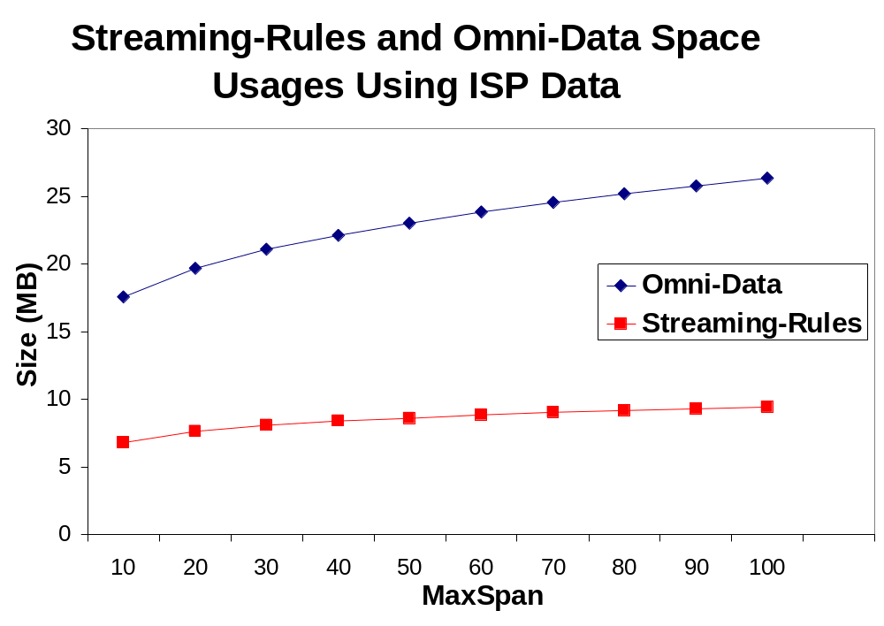
Space Usage - ISP Data N = 6*10⁵

Slide 41
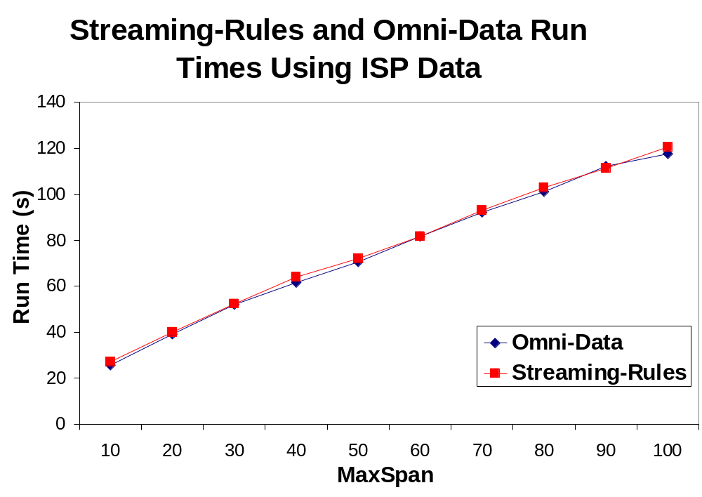
Time Usage - ISP Data N = 6*10⁵

Slide 42
Conclusion
Contributions:
  A new model for mining (forward and backward) association between elements in data streams
  A solution to Anupam’s hit inflation mechanism that was never detected before
  A new algorithm for solving the proposed problem with limited processing per element and space
  Guarantees on results
  Experimental validation

